Slide 1

OpenCV - Introduction
PART I
REF: TAKEN FROM
HTTPS://OPENCV-PYTHON-TUTROALS.READTHEDOCS.IO/EN/LATEST/PY_TUTORIALS/PY_TUTORIALS.HTML

Slide 2
Load an image
#load_image.py
import numpy as np
import cv2
# Load an color image in grayscale
img = cv2.imread(‘frog.png',0)
Even if the image path is wrong, it won’t throw any error, but print img will give you None

Slide 3
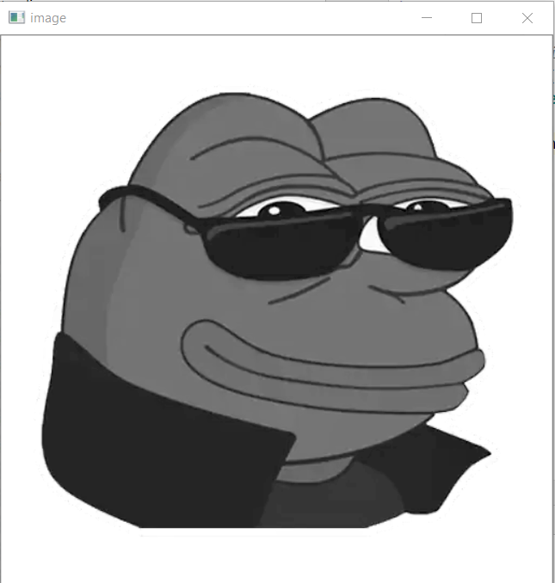
Display an image
There is a special case where you can already create a window and load image to it later. In that case, you can specify whether window is resizable or not. It is done with the function cv2.namedWindow(). By default, the flag is cv2.WINDOW_AUTOSIZE. But if you specify flag to be cv2.WINDOW_NORMAL, you can resize window. It will be helpful when image is too large in dimension and adding track bar to windows.
ccv2.namedWindow('image', cv2.WINDOW_NORMAL)
cv2.imshow('image',img)
cv2.waitKey(0)
cv2.destroyAllWindows()

Slide 4
Display an image – With pre- created window
cv2.imshow('image',img)
cv2.waitKey(0)
cv2.destroyAllWindows()
Notes:
cv2.waitKey() is a keyboard binding function. Its argument is the time in milliseconds. The function waits for specified milliseconds for any keyboard event. If you press any key in that time, the program continues. If 0 is passed, it waits indefinitely for a key stroke. It can also be set to detect specific key strokes like, if key a is pressed etc which we will discuss below.
cv2.destroyAllWindows() simply destroys all the windows we created. If you want to destroy any specific window, use the function cv2.destroyWindow() where you pass the exact window name as the argument.

Slide 5
Store the image - imwrite
Use the function cv2.imwrite() to save an image.
First argument is the file name, second argument is the image you want to save.
cv2.imwrite('messigray.png',img)
Notes:
Use the function cv2.imwrite() to save an image.
First argument is the file name, second argument is the image you want to save.
cv2.imwrite('messigray.png',img)

Slide 6
Finally
Writte a program to load an image in grayscale, display it and save the image if ‘s’ is pressed and exit. Or simply exit without saving it when you press ESC key
import numpy as np
import cv2
img = cv2.imread(‘frong.jpg',0)
cv2.imshow('image',img)
k = cv2.waitKey(0) & 0xFF
if k == 27: # of 0x1B wait for ESC key to exit
cv2.destroyAllWindows()
elif k == ord('s'): # wait for 's' key to save and exit
cv2.imwrite('messigray.png',img)
cv2.destroyAllWindows()

Slide 7
Display image from Camera

Slide 8
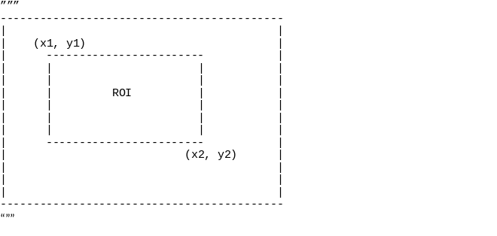
ROI
roi = gray[y1:y2, x1:x2]
cnts = cv2.findContours(grayscale_image, cv2.RETR_EXTERNAL, cv2.CHAIN_APPROX_SIMPLE)
cnts = cnts[0] if len(cnts) == 2 else cnts[1]
ROI_number = 0
for c in cnts:
x,y,w,h = cv2.boundingRect(c)
ROI = image[y:y+h, x:x+w]
cv2.imwrite('ROI_{}.png'.format(ROI_number), ROI)
ROI_number += 1

Slide 9
from PIL import Image
def crop(image_path, coords, saved_location:
image_obj = Image.open("Path of the image to be cropped")
cropped_image = image_obj.crop(coords)
cropped_image.save(saved_location)
cropped_image.show()
if __name__ == '__main__':
image = "image.jpg"
crop(image, (100, 210, 710,380 ), 'cropped.jpg')

